Slide 1









WORLD FORUM FOR A SUSTAINABLE SOCIETY
16th Annual Conference on
Social Sustainability through Competitiveness with Qualitative Growth
11 - 12 October 2013, Sofia University, Sofia, Bulgaria
Organizing universities
Sofia University “St. Kliment Ohridski”
Faculty of Economics and
Business Administration
Humboldt-Universität
zu Berlin
University of Cologne
Faculty of Management,
Economics and Social Sciences
Angelo State University
College of Business, Texas, USA
FIRST ANNOUNCEMENT

Slide 2
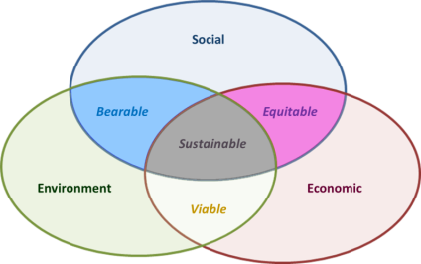
WORLD FORUM FOR SUSTAINABLE SOCIETY
16th Annual Conference on
Social Sustainability through Competitiveness with Qualitative Growth
11 - 12 October 2013, Sofia University, Sofia, Bulgaria
CLUB OF SOPHIA
Club of Sophia is initiated by two universities: Sofia University, Bulgaria, Humboldt University Berlin, Germany.
Annually, the Club of Sophia organizes in Aula Magna at Sophia University in Bulgaria, the
WORLD FORUM FOR SUSTAINABLE SOCIETY,
inviting worldwide leading scientists, researchers, educators and entrepreneurs to discuss ways of creating sustainable society. The World forum for a sustainable society is a continuation of the Annual Conferences of the Faculty of Economics and Business Administration, Sofia University
Club of Sophia Coordinating Board:
Prof. Dr. Joachim Schwalbach, Humboldt University in Berlin
Prof. Dr. Dieter Flaemig, Berlin
Prof. Dr. George Chobanov, Sofia University in Bulgaria, General Secretary
E-mail: georgech@feb.uni-sofia.bg

Slide 3
WORLD FORUM FOR A SUSTAINABLE SOCIETY
organized by
CLUB OF SOPHIA
16th Annual Conference on
Social Sustainability through Competitiveness with Qualitative Growth
11 - 12 October 2013, Sofia University, Sofia, Bulgaria
Organizing Committee
CO-CHAIRS
Prof. Dr. George CHOBANOV
Prof. Dr. Dieter FLAEMIG
Prof. Dr. Joachim SCHWALBACH
Prof. Dr. Gernot GUTMANN
Prof. Dr. Kai-Ingo VOIGT
Prof. Dr. Corbett GAULDEN
Prof. Dr. Djellal FARIDAH
MEMBERS
Prof. Dr. Frank SCHULZ-NIESWANDT
Prof. Dr. Henrik EGBERT
Prof. Dr. Ralph ANDEREGG
Prof. Dr. Hermann ALBECK
Prof. Dr. Juergen PLOEHN
Prof. Dr. Jean-Pierre GERN
Prof. Dr. Albena VUTSOVA
Prof. Dr. Alexander NIKOLOV
Prof. Dr. Teodor SEDLARSKI
Prof. Dr. Jelio VLADIMIROV
Prof. Dr. Dimiter BIROV
Prof. Dr. Yana TOPALOVA
Prof. Dr. Detelin ELENKOV
Dr. Ralitsa GANEVA
Dr. Kaloyan GANEV
FIRST ANNOUNCEMENT

Slide 4
WORLD FORUM FOR A SUSTAINABLE SOCIETY
CLUB OF SOPHIA
MISSION
Club of Rome recognized already in the early seventies that due to intensive use of limited natural resources, human population is quite quickly reaching its disaster critical point. Since then, a lot of measures were undertaken for sustainable use of resources and for environmental protection. Sustainable development became a worldwide movement concentrating on sustainable use of resources. Nevertheless, up to now it did not succeed to essentially slowdown the movement towards the potential catastrophe.
Issues of environmental sustainability go beyond environmental protection and sustainable use of resources and involve economic and social sustainability of human society as well! Especially these impacts imply a new thinking and acting, which have to leave traditional pattern of thoughts.
Club of Sophia considers its mission to initiate an international science-based movement for creating sustainable society involving social, economic and environmental sustainability, including incentives for practical changes of human behavior. Financial and economic crises last years made clear, that sustainable social and economic development of human society requires basic changes in economic theory, human behavior norms and the value system of society.
Existing economic theory is basically build up on the dominance of the own utility principle. This is a necessary, but not sufficient condition for sustainable societies. For its sustainability, society needs a long term balance by adding the common utility principle based on the necessities of today and tomorrow. Balance of public and private utility allows harmony in a society for a longer period of time. This is not new. It is already a fundamental component of the classical works of Adam Smith “The Wealth of Nations” and “The Theory of Moral Sentiments”. Unfortunately, most of the later developments in modern economic theory referred to the first reference, ignoring the second one. This brought essential distortions in human behavior norms, being directed mainly towards a society of profit maximization.

Slide 5
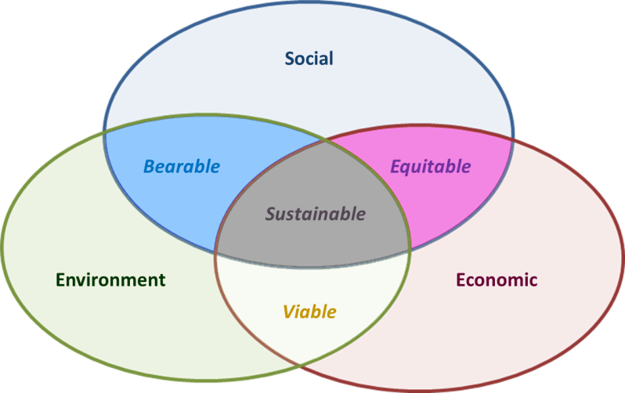
WORLD FORUM FOR A SUSTAINABLE SOCIETY
CLUB OF SOPHIA
MISSION
Currently, theoretical developments, mainly in Institutional Economics are concerned with rules and behavior norms in human society.
In the recent past, we were able to recognize tendencies like Good Corporate Governance, Corporate Social Responsibility, Social Entrepreneurship, approaching common values of human society.
Club of Sophia is a forum addressing those, who accept a value system based on harmony of nature and society, on harmony of individual and common values, balancing public and private utilities without ignoring the needs of efficiency. This harmony incorporates ancient societies’ wisdom.
Sophia is wisdom.
Club of Sophia is for those, who like to live worldwide in a wise society. Wise society is synergistically sustainable in its three aspects: ecological, economic and social. We do not wait for the Prophet. The communicating, feeling and creating human society is the Prophet. We do not only recognize problems, we suggest solutions. We would like to promote an interdisciplinary science movement towards a science for a global sustainability – with a strong and efficient transfer to practical users.

Slide 6

WORLD FORUM FOR A SUSTAINABLE SOCIETY
16th Annual Conference on
Social Sustainability through Competitiveness with Qualitative Growth
11 - 12 October 2013, Sofia University, Sofia, Bulgaria
MAIN STREAMS OF THE FORUM
I. Economic theory of sustainability in societies and business
II. Sustainable entrepreneurial behavior and its framework
III. Implementation and optimisation of sustainable developments
IV. Education and training for sustainable developments

Slide 7

WORLD FORUM FOR A SUSTAINABLE SOCIETY
16th Annual Conference on
Social Sustainability through Competitiveness with Qualitative Growth
11 - 12 October 2013, Sofia University, Sofia, Bulgaria
PAPERS SUBMISSION
English is the working language of the Conference.
Proposals for contributions have to be sent before August 30, 2013
Full text submission: September 30, 2013
Contact Person: Ivanka Djakova conference@feb.uni-sofia.bg
Selected papers will be published in special volumes by Springer Verlag or by Peter Lang Verlag
Participants can submit papers for short (15 min) presentation or a keynote speech (30 min) in a stream. Participants can suggest streams as well. Suggested streams, so far:
I. Economic theory of sustainability in societies and business
S11. Clusters, Flows, and Economic Performance in a Sustainable Economic System (George Chobanov)
S12. Sustainability of Eco-Efficiency and Eco-Innovations (Joachim Schwalbach)
II. Sustainable entrepreneurial behavior and its framework
S21.
III. Implementation and optimisation of sustainable developments
S31. The Power of Consumers as Central Element of the Global Turnaround (Dieter Flämig).
IV. Education and training for sustainable developments.
S41. Doctoral Academy in Sustainable Development Management (Joachim Schwalbach, Alexander Nikolov, Henrik Egbert)

Slide 8
WORLD FORUM FOR A SUSTAINABLE SOCIETY
16th Annual Conference on
Social Sustainability through Competitiveness with Qualitative Growth
11 - 12 October 2013, Sofia University, Sofia, Bulgaria
DOCTORAL WORKSHOP
The doctoral workshop has a special session at the World Forum. It took place for the first time in 2012. This year’s workshop will particularly address interdisciplinary research in the fields of sustainability in a globalized context. We are inviting PhD candidates from social sciences, law, business sciences and economics as well as from natural sciences and engineering to engage in a dialogue on solutions for global challenges of sustainability. Proposals may address the scientific topics in the main streams of the World Forum but do not necessarily have to be limited to these. Rather they should investigate subjects representing cutting edge fields of research.
The workshop offers PhD candidates a unique possibility to present and discuss their research projects in an inspiring academic community of both fellow PhD students and experienced researchers. A friendly and supportive atmosphere will allow students to improve their academic skills and abilities as well as to connect with international PhD colleagues and faculty members.

Slide 9
WORLD FORUM FOR A SUSTAINABLE SOCIETY
16th Annual Conference on
Social Sustainability through Competitiveness with Qualitative Growth
11 - 12 October 2013, Sofia University, Sofia, Bulgaria
DOCTORAL WORKSHOP
Admission:
Participants of the doctoral workshop will be selected by a scientific committee based on submitted abstracts of maximum 500 words. Proposals should indicate the stage of the PhD process, the research question, central propositions, and the methodological design.
Applications should further include a current CV, the name(s) of their supervisor(s), and a confirmation that they are currently registered as PhD students.
Participants chosen to present their research should be prepared to submit a full proposal of 3000 words. Presentations will be limited to 20 minutes with additional 30 minutes for discussion.
Abstract submissions should be sent in PDF format to Mrs. Gergana Stoilova email: phd-project@feb.uni-sofia.bg until May 1st, 2013.
Notifications of admission will be sent by email on June 1st, 2013.
Full papers should be sent to Mrs. Gergana Stoilova until September 1st, 2013.
We offer a limited number of non-presenting students to attend the workshop as guests and discussants. Applications should also be sent to Mrs. Gergana Stoilova

Slide 10
WORLD FORUM FOR A SUSTAINABLE SOCIETY
16th Annual Conference on
Social Sustainability through Competitiveness with Qualitative Growth
11 - 12 October 2013, Sofia University, Sofia, Bulgaria
DOCTORAL WORKSHOP
Cost and Fees:
Participants of the doctoral workshop will have to register at the normal conference fee for students which is 40 €. It allows participants to attend the workshop as well as all conference sessions. Accommodation and travel will be at the participants’ own expenses.
Scientific Committee:
Joachim Schwalbach (Humboldt-University of Berlin), chairman
Alexander Nikolov (St. Kliment Ohridski University in Sofia)
Henrik Egbert (Anhalt University of Applied Sciences, Germany
Contact:
For submission of papers and for any further information regarding the doctoral workshop please contact: Mrs. Gergana Stoilova
email: phd-project@feb.uni-sofia.bg
Information about the DASUN project: http://phd.feb.uni-sofia.bg

Slide 11
WORLD FORUM FOR A SUSTAINABLE SOCIETY
16th Annual Conference on
Social Sustainability through Competitiveness with Qualitative Growth
11 - 12 October 2013, Sofia University, Sofia, Bulgaria
REGISTRATION
Deadline | Registration Fee
Up to September 15st 2013 | □ 250 EUR
After September 15st /On spot | □ 350 EUR
Delegate’s Registration fee includes:
Access to the plenary sessions
Access to the poster session
Delegate’s kit
Social Events

Slide 12
WORLD FORUM FOR A SUSTAINABLE SOCIETY
16th Annual Conference on
Social Sustainability through Competitiveness with Qualitative Growth
11 - 12 October 2013, Sofia University, Sofia, Bulgaria
ACCOMMODATION
Hotel | Single room per night | Double room per night
Hotel 5* | □ 105 EUR | □ 125 EUR
Hotel 4* | □ 90 EUR | □ 115 EUR
Hotel 3* | □ 45 EUR | □ 50 EUR
In case of double room, please, fill in the name of the second person: …………………………………………………………………………………………………..
Period: □ 10 October □ 11 October □ 12 October
Total number of nights: ………………..

Slide 13
WORLD FORUM FOR A SUSTAINABLE SOCIETY
16th Annual Conference on
Social Sustainability through Competitiveness with Qualitative Growth
11 - 12 October 2013, Sofia University, Sofia, Bulgaria
SOCIAL PROGRAM
TOURS
Sofia City Tour – half day tour
On 13 October morning □ 35 EUR
Perperikon – one day tour
(Worldwide unique higher energy place)
On 13 October morning □ 56 EUR

Slide 14





WORLD FORUM FOR A SUSTAINABLE SOCIETY
16th Annual Conference on
Social Sustainability through Competitiveness with Qualitative Growth
11 - 12 October 2013, Sofia University, Sofia, Bulgaria
Conference Sponsors
Media Partners
FIRST ANNOUNCEMENT
Notes:
14

